Slide 1

Monitoring and Forecasting of Crop Output to Mitigate Risk
An LAI Based Predictive Modeling
From
Aishvarya Gopalasamy
Raghavi Ravi
Hariharan Ramesh
Sushma Munaganti
For Gaiadhi
Karthik Kannappan
CEO, Gaiadhi Agtech
Vasu Vijay
CTO, Gaiadhi Agtech

Slide 2
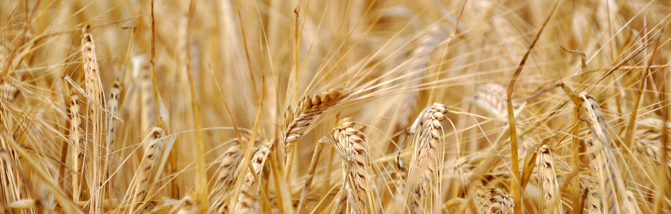
About the Company
Partnership
Texas A&M AgriLife (TAMU) on a USDA-funded project focused on climate-smart and regenerative cotton production practices.
Tamil Nadu Agricultural University (TNAU) for precision farming research.
University of California, Davis (UCD).
Centre of Excellence on Watershed Management in Bangalore for discussions on collaborative efforts in regenerative farming.
Gaiadhi (also known as GaiaDhi AgTech) is a US-based agricultural technology (AgTech) company that provides data-driven solutions for farm planning and operations to improve profitability and sustainability. The company is based in San Jose, California
The Holos platform leverages a combination of dynamic and responsive crop simulation models (CSMs) and AI models to provide near real-time forecasts and recommendations at a high spatial resolution

Slide 3
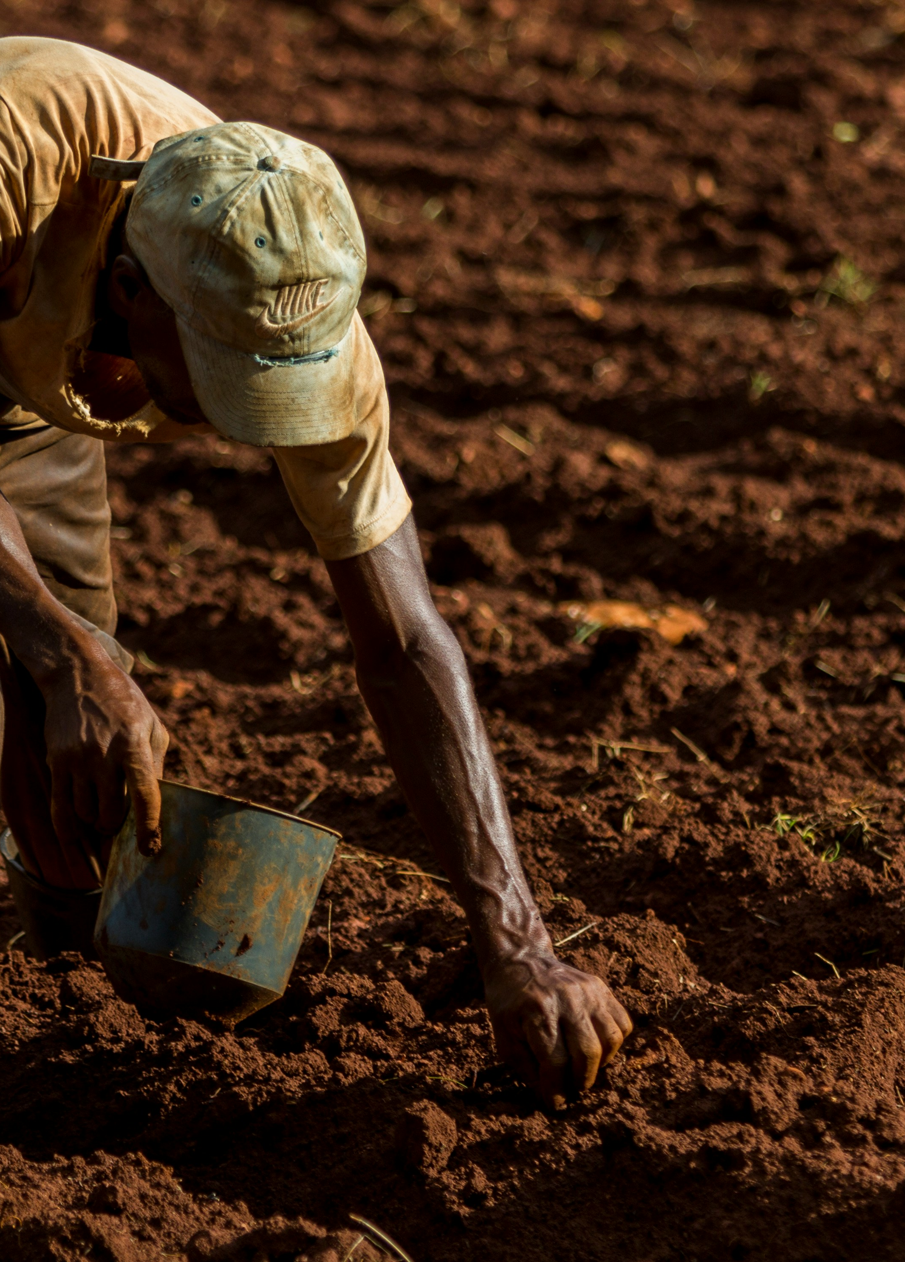
What This Project Is About
This project focuses on monitoring and forecasting the growth of cotton crops using Leaf Area Index (LAI) as the primary indicator of crop health and productivity.
Why LAI?
LAI reflects how much leaf area the plant has, which directly relates to Crop vigor, Photosynthetic activity, Biomass accumulation and Expected yield. When LAI does not increase as expected, the crop is likely under stress.
What We Aim to Do
Using 5 years of DSSAT/Holos cotton simulation data (2019–2023), the project aims to
Predict future LAI (next X days) using AI models.
Detect whether the crop is growing normally or showing stress.
Analyze environmental factors (weather, soil nitrogen, soil moisture) that influence LAI.
Understand crop behavior over the season and identify unusual growth patterns.
Introduction & Problem Statement
Why This Is Important
Early detection of crop stress helps farmers take timely action. Forecasting LAI supports yield planning, risk reduction, and decision-making in precision agriculture. This project demonstrates how AI + crop models can enhance modern agricultural monitoring.

Slide 4

DSSAT/Holos Simulation Outputs (Primary Data)
We used daily crop-simulation outputs for cotton from the Snook Test Farm (TAMU) covering 2019–2023. Each file provides a different layer of plant, soil, and environmental information.
Plant Growth Data — PlantGro.OUT - Contains daily plant physiological variables.
Soil Nitrogen Data — SoilNi.OUT - Captures nitrogen content at multiple soil depths
Soil Moisture Data — SoilWat.OUT - Provides volumetric soil water at various root-zone depths
Weather Data — Weather.OUT - Daily atmospheric conditions
Data Sources
Data Integration
All four files were merged using
RUNNO (simulation run ID)
DAP (days after planting)
This produced a single dataset with 46+ combined features, representing Plant growth, Soil nutrient status, Soil moisture, Weather drivers
This unified dataset forms the foundation for forecasting LAI and detecting crop stress.

Slide 5
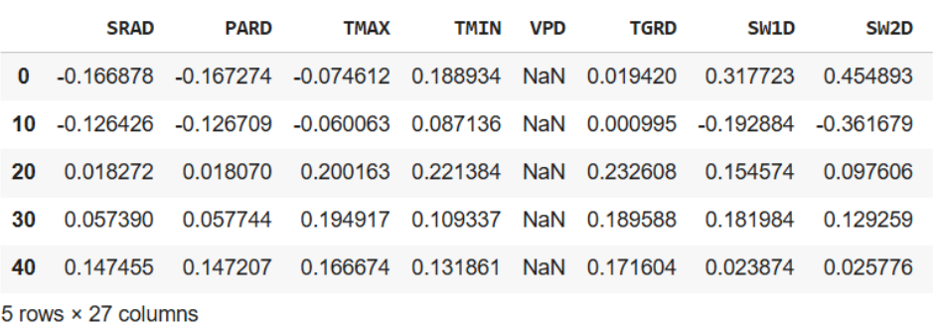
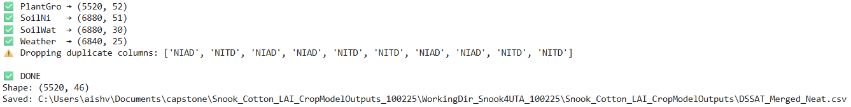
Why Was Data Cleaning Needed?
The DSSAT OUT files are not uniform, contain metadata blocks, and use fixed-width formatting. To build a usable dataset, several cleaning steps were required.
Parsing Simulation Metadata
Each OUT file contains header sections with:
RUNNO (run ID)
TRTNO / TRTNA (treatment information)
Planting year & run structure.
We extracted these identifiers, so every row is correctly linked to its simulation.
Standardizing Column Names
Across different files, column names were inconsistent.
RUN, RUNNO., RUNNO - Standardized to RUNNO
LAI sometimes appears as LAID or in different positions.
Soil & moisture depths required renaming for consistency.
This step ensured all variables aligned properly.
Final Output
The cleaned tables were successfully merged into:
DSSAT_Merged_Neat.csv
This dataset includes
All plant, soil, and weather variables
5 years of simulations
46+ fully cleaned and aligned features
Ready for feature engineering & modeling
Data Cleaning

Slide 6
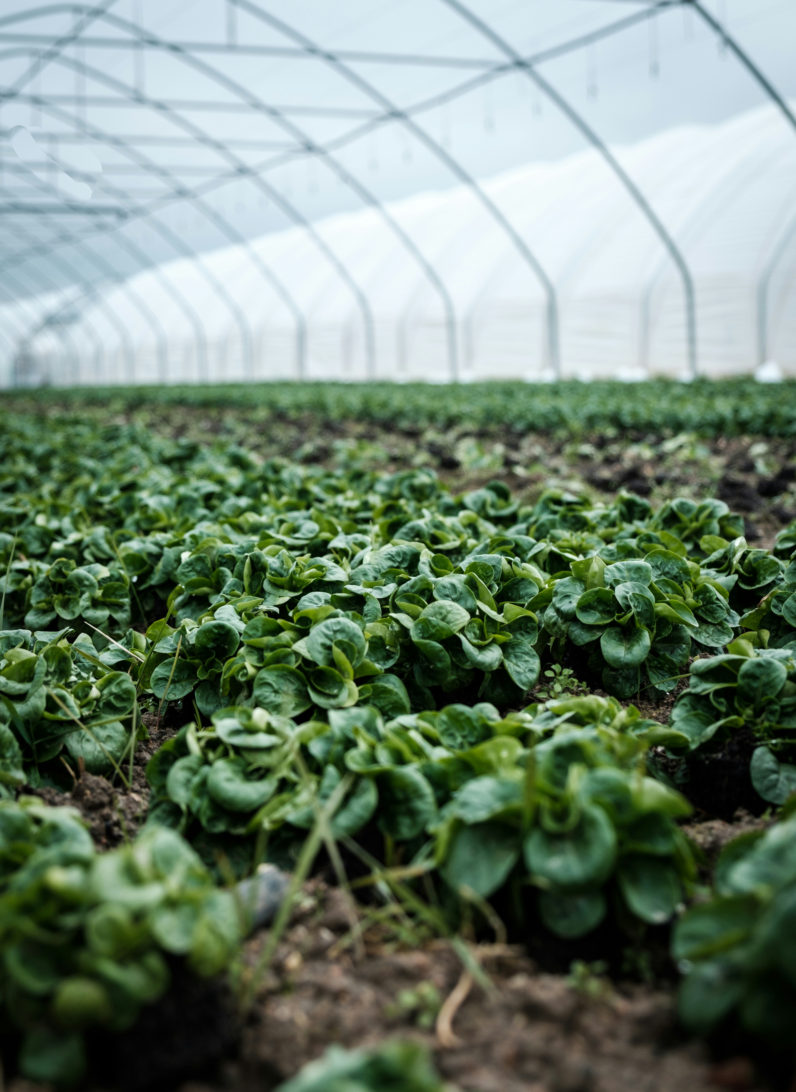
Feature Engineering
Overview
Why Feature Engineering?
To forecast LAI accurately, the model must understand
Environmental drivers (weather, soil nitrogen, soil moisture)
Temporal behavior (recent LAI history)
Seasonal progression (DAP)
Goal of Feature Engineering
Build a model-ready representation of crop growth conditions to capture:
Daily LAI Changes
Stress Signals
Stage Transitions
Environmental Interactions
Methods Used
Correlation Analysis
Partial Correlations
Stage-based Correlation
Linear & Lasso Modeling
Random Forest Importance
Mutual Information
Scatter + LOESS curves

Slide 7
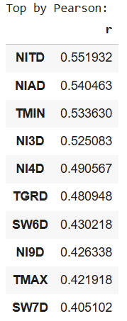
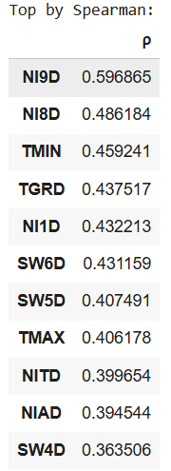
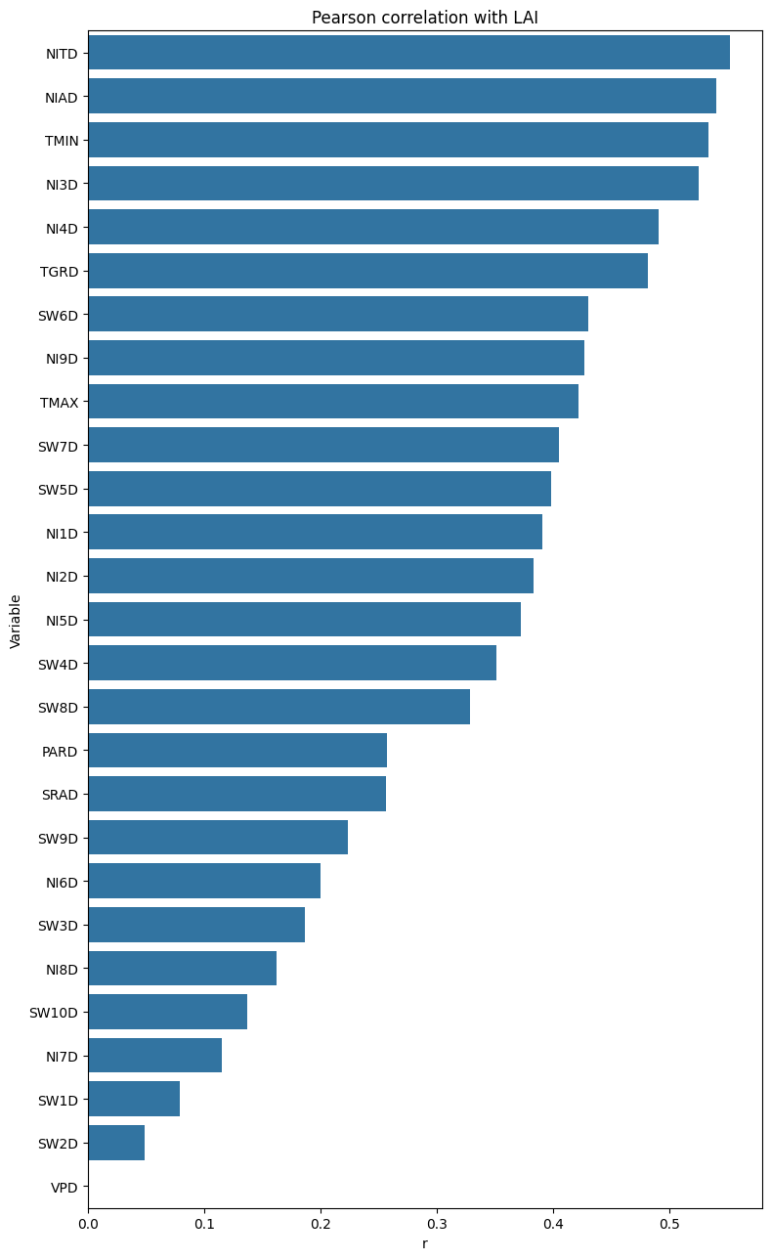
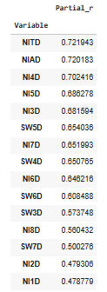
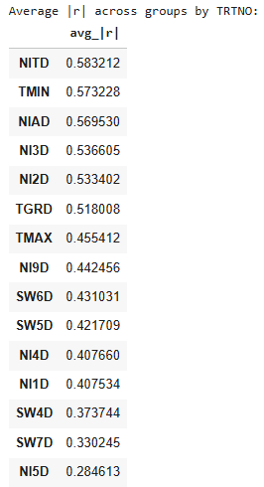
Statistical Feature Importance
Correlation Analysis
We computed Pearson & Spearman correlations between all environmental variables and LAI.
Pearson - Linear Relation
Spearman – Monotonic Nonlinear Relation
Key Output
Top drivers usually include
Soil moisture depths (SW6D, SW7D, SW8D)
Soil nitrogen (NITD, NIAD)
Thermal time (TGRD)
Partial Correlation
Controlled for:
DAP
DOY
RUNNO
TRTNO
This isolates the true environmental influence after removing “time” and “run” effects.
Group-wise Correlation
Correlation computed per treatment / per run.
Consistent high-|r| across runs indicates robust LAI drivers.

Slide 8
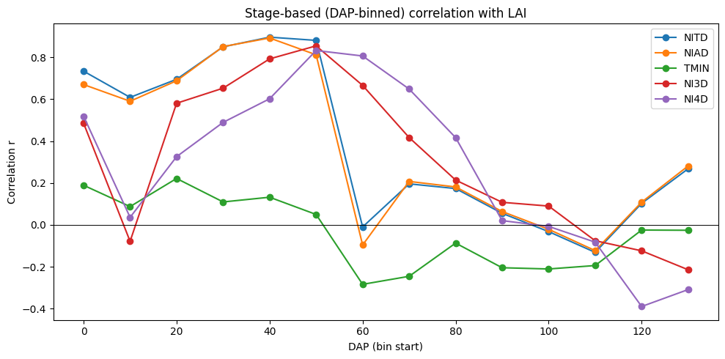
Stage-Based Feature Behavior (DAP Binning)
Why Stage-Based Analysis?
Environmental influence on LAI changes by:
Early-season (emergence)
Vegetative expansion
Peak LAI period
Senescence
We binned DAP into 10-day windows and computed correlation in each stage.
What We Learned
Soil moisture influences LAI most strongly during vegetative expansion.
Nitrogen variables show stronger impact around peak LAI period.
Thermal time (TGRD) contributes throughout the season but stabilizes later.

Slide 9
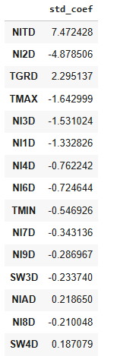
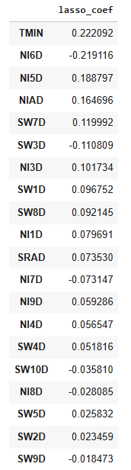
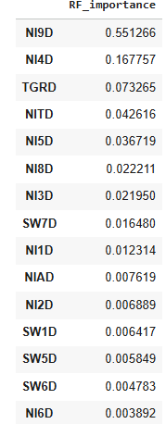
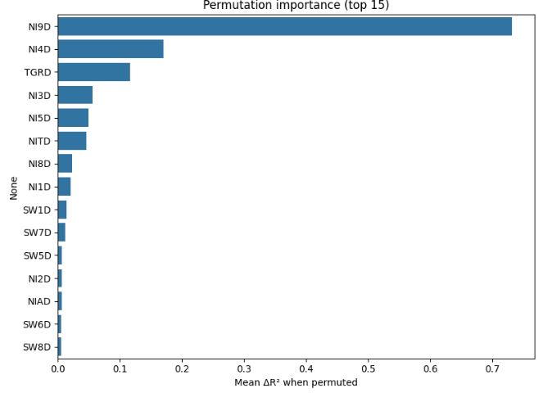
Model-Based Feature Selection
Standardized Linear Regression
Fitted a scaled linear model to quantify effect size.
Variables with largest standardized coefficients influence LAI the most.
LassoCV (L1 Regularization)
Automatically selects a sparse set of non-redundant features.
Chosen variables represent core environmental drivers.
Random Forest Importance
Nonlinear model measuring reduction in impurity.
Confirms key drivers from correlation analysis.
Permutation Importance
Most reliable model-agnostic importance:
Measures drop in R² when a feature is shuffled.

Slide 10
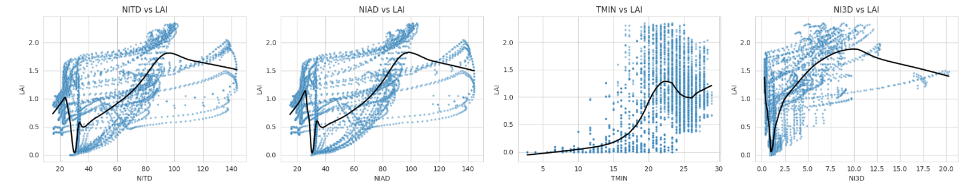
Final Selected Features (With Graphs)
Final Feature Set Used For Modeling
Environmental Drivers
Based on correlation, RF, MI, Lasso:
Soil moisture - SW6D, SW7D, SW8D
Soil nitrogen - NIAD, NITD, NI3D–NI5D
Weather - TMIN, TGRD
Graph: Visual Relationships
Scatterplots of top variables vs LAI with LOESS smoothing show:
Increasing LAI with increasing moisture/nitrogen
Saturation after a threshold
Clear physiological relevance

Slide 11
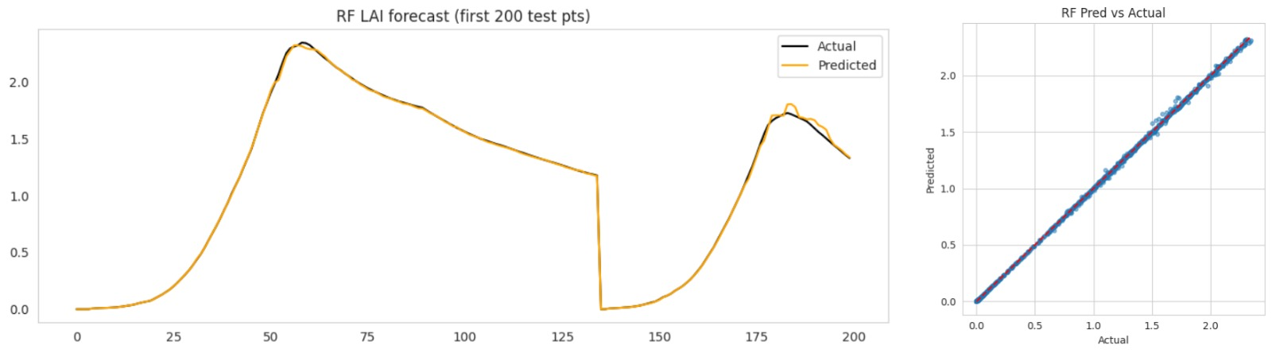
Random Forest Model – Training and Results
Model Setup
Inputs – Environmental Features + LAI lag (t-1, t-2, t-3) + DAP
Split - 80% Training | 20% Testing
Scaler applied to stabilize feature values
Model Used - Random Forest Regressor (400 trees)
Key Results
Scatterplots of top variables vs LAI with LOESS smoothing show:
Accurately follows LAI growth pattern across the season.
Predictions overlap closely with actual LAI curve.
Predicted vs actual scatter aligns nearly on the 1:1 line → very low error & high stability.

Slide 12
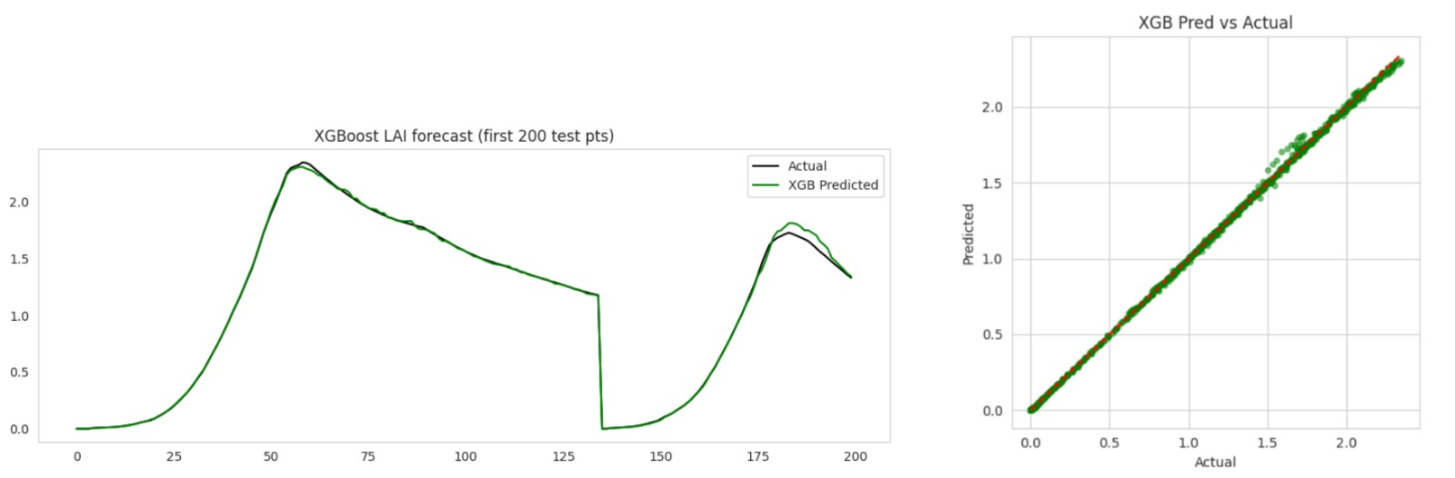
XGBoost Model – Training and Results
Model Setup
Same lagged dataset as Random Forest.
Input Features - Environmental Variables + LAI lags (t−1, t−2, t−3) + DAP.
350 Boosting Rounds.
Depth = 5 | Learning rate = 0.05.
Regularization (L2 = 1.0)
Key Results
Smooth and Consistent LAI Predictions.
Captures non-linear patterns effectively.
Predicted vs Actual shows tight clustering - High Accuracy across DAP.

Slide 13
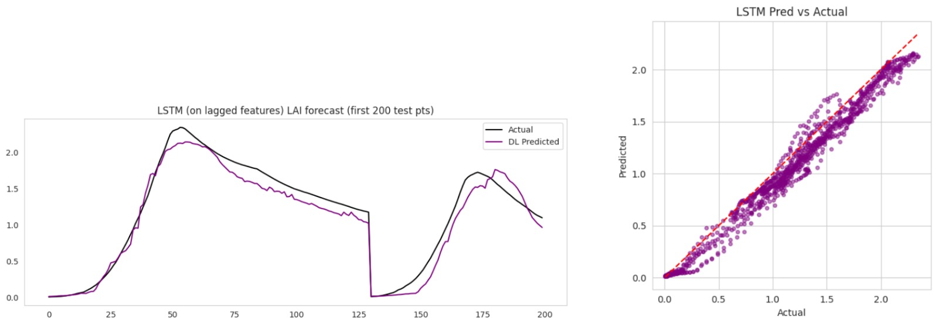
LSTM Model – Training and Performance
Model Setup
Input Window - 5-timestep Sequences.
Features - Environmental Variables + lagged LAI + DAP.
Architecture .
LSTM(64) - Dropout(0.2) - Dense(32) - Output(1).
Loss – MSE.
Optimization - Adam
Key Results
Able to learn temporal patterns in LAI.
Slightly underfits peak and late-season values.
More variation around actual values - less stable than tree models.

Slide 14
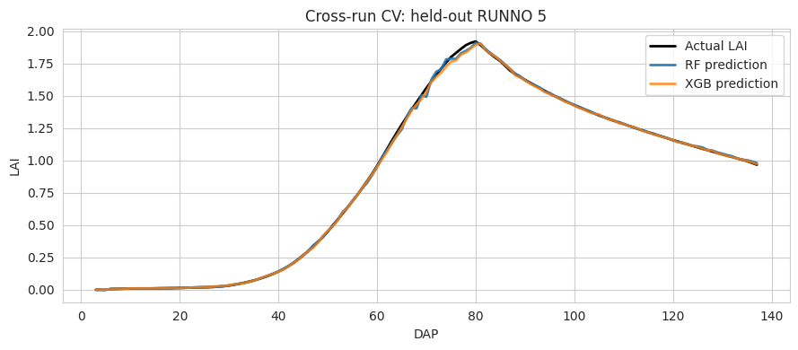
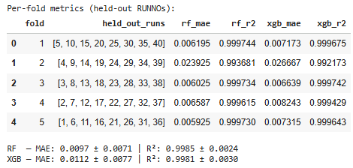
Cross-Run Validation
Why We Did This
Each DSSAT simulation has multiple RUNNO values (different management/treatment scenarios).
To check if our model is generalizable and not overfitting to one run, we must test it on completely unseen RUNNOs.
This is exactly why we used GroupKFold, where each fold holds out an entire RUNNO.
Key Results
RF & XGB show consistent performance across all held-out runs.
High R² (≈0.99) and low MAE across folds.
Both models accurately reconstruct unseen growth curves.

Slide 15
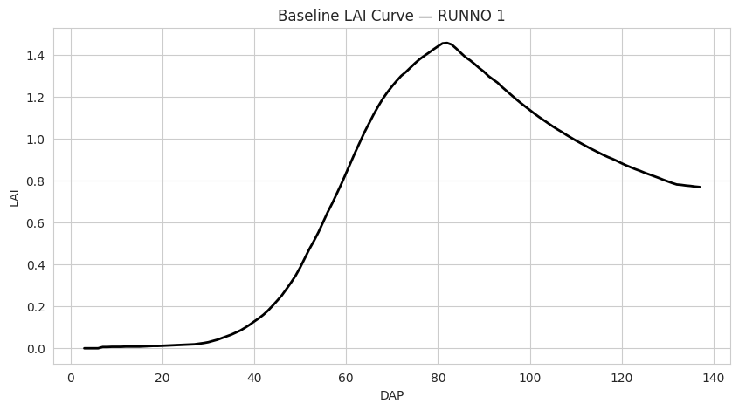
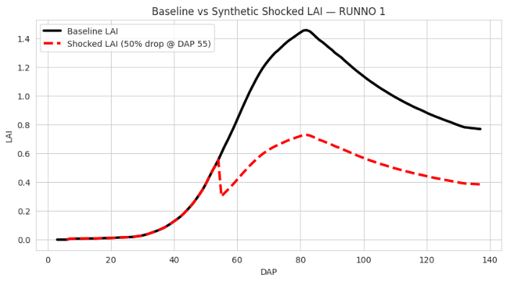
Synthetic Shock Experiment
Method
Selected a healthy baseline run (RUNNO 1).
Applied a synthetic 50% LAI drop at DAP 55.
Recomputed LAI lags to maintain model structure.

Slide 16
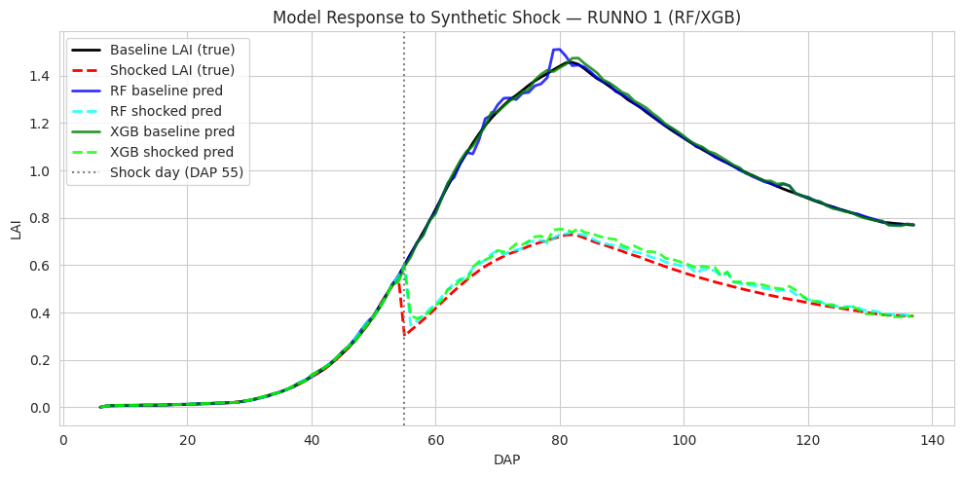
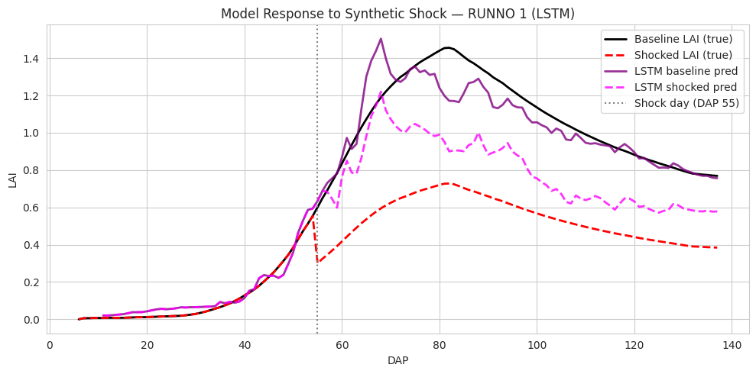
Model Response to Synthetic Shock
Key Takeaways
RF and XGB are highly stable under abrupt environmental shocks.
LSTM struggles, confirming it is not the preferred model for real-time stress detection with this dataset.
Shock testing validates that our main models behave consistently and realistically even when data deviates from expected growth patterns.

Slide 17
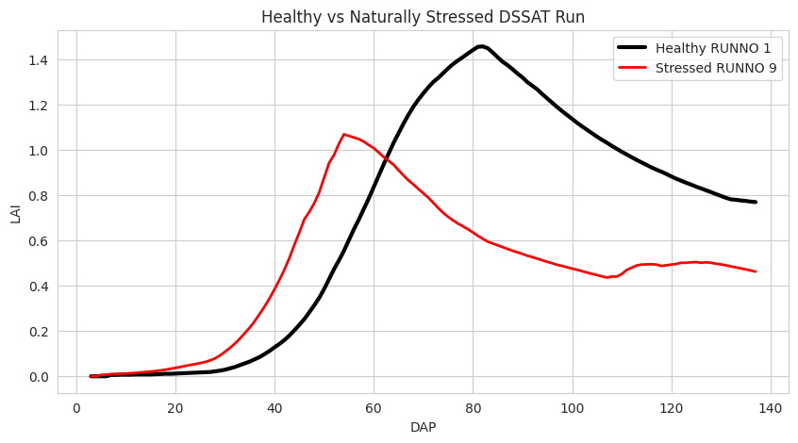
Real DSSAT Stress Detection - Healthy vs Naturally Stressed Run
Key Takeaways
This graph provides the real biological stress curve that we later compare with:
  Synthetic Shock.
  Model Predictions (RF/XGB/LSTM).
  Helps verify whether models can distinguish healthy vs stressed trajectories.

Slide 18

Purpose
Compare how RF, XGB, and LSTM models respond to:
  Healthy Growth Trajectory.
  Synthetic stress event (50% LAI drop at DAP 55).
  Naturally stressed DSSAT run
Insights
Model Predictions - Baseline vs Synthetic Shock vs Real Stress
Tree Models (RF & XGB)
Respond quickly to shock; maintain stable patterns under real stress.
LSTM
Captures temporal dependencies strongly; reacts more sharply to stress signals..
Validation
Synthetic shock behavior closely mirrors real DSSAT stress trends - Confirms our approach for evaluating model robustness and anomaly response.

Slide 19
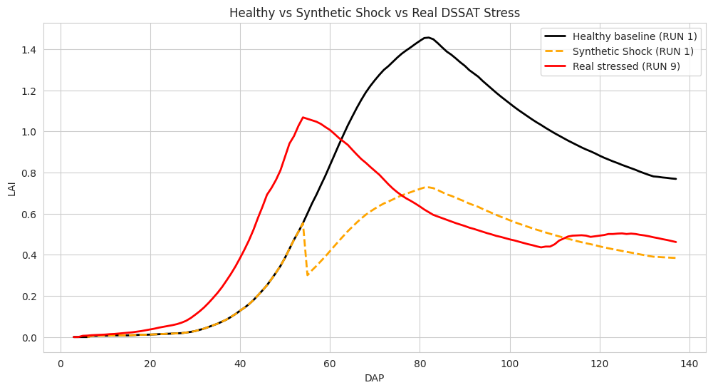
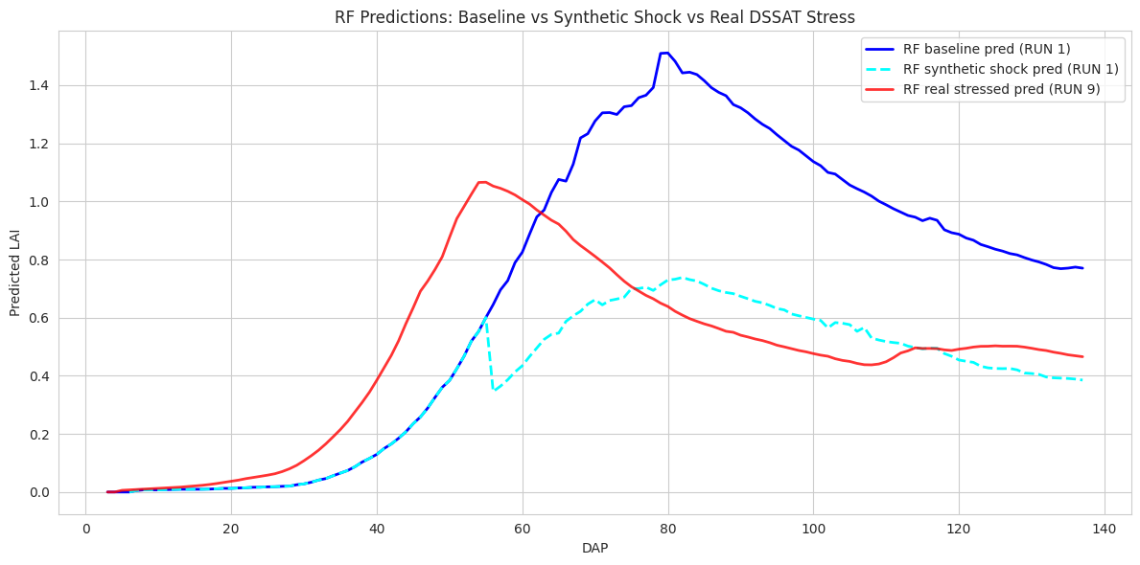
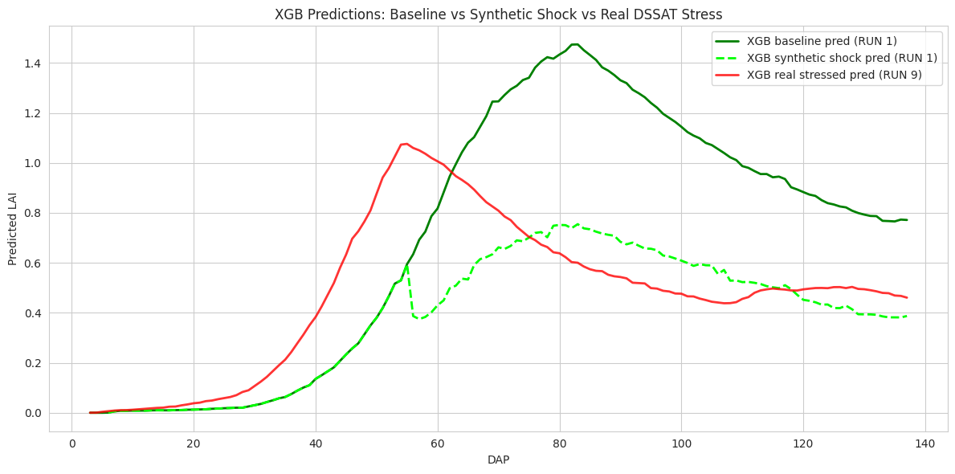
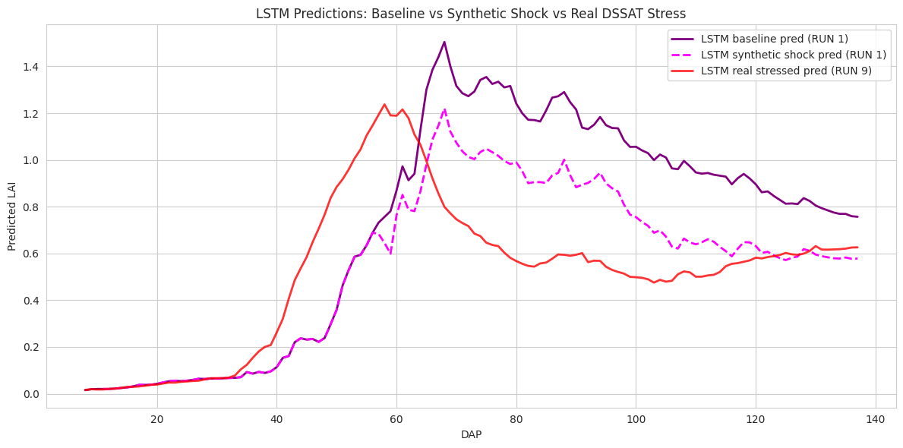
Model Predictions - Baseline vs Synthetic Shock vs Real Stress

Slide 20
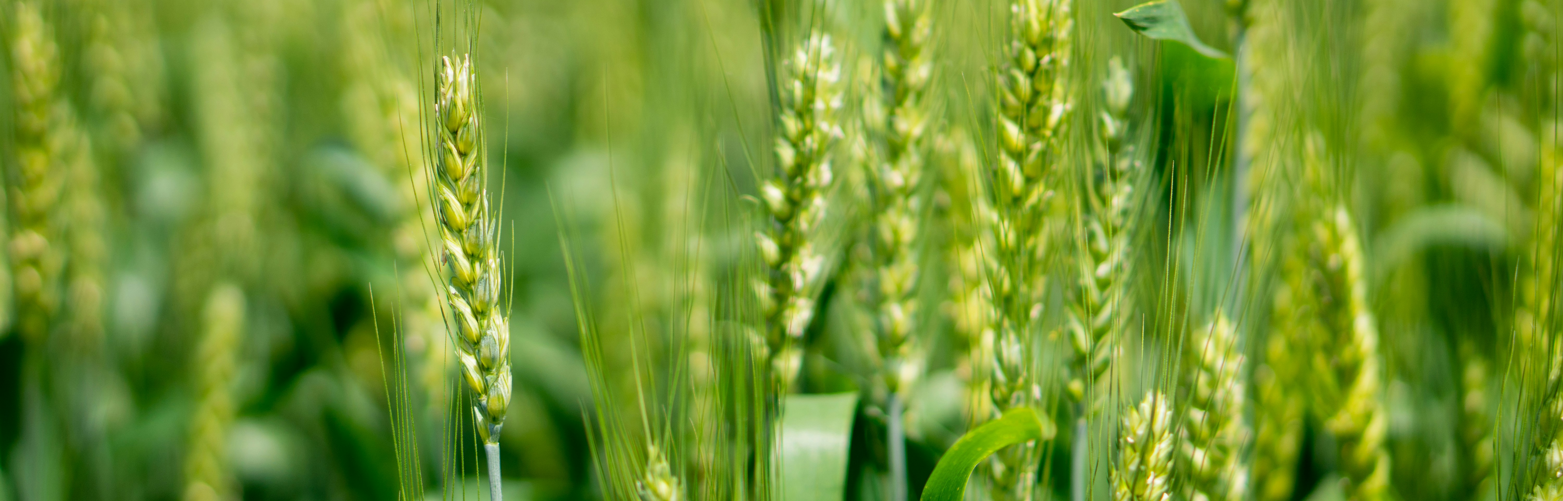
Demo Inferencing
Operational
Pipeline
Ingest recent LAI observations (model or satellite).
Forecast next 5–10 days of LAI.
Compare predicted vs. expected baseline.
Generate Deviation Score.
Provide “On-Track / Off-Track” Insights.
This serves as the engine for real-time crop monitoring.

Slide 21
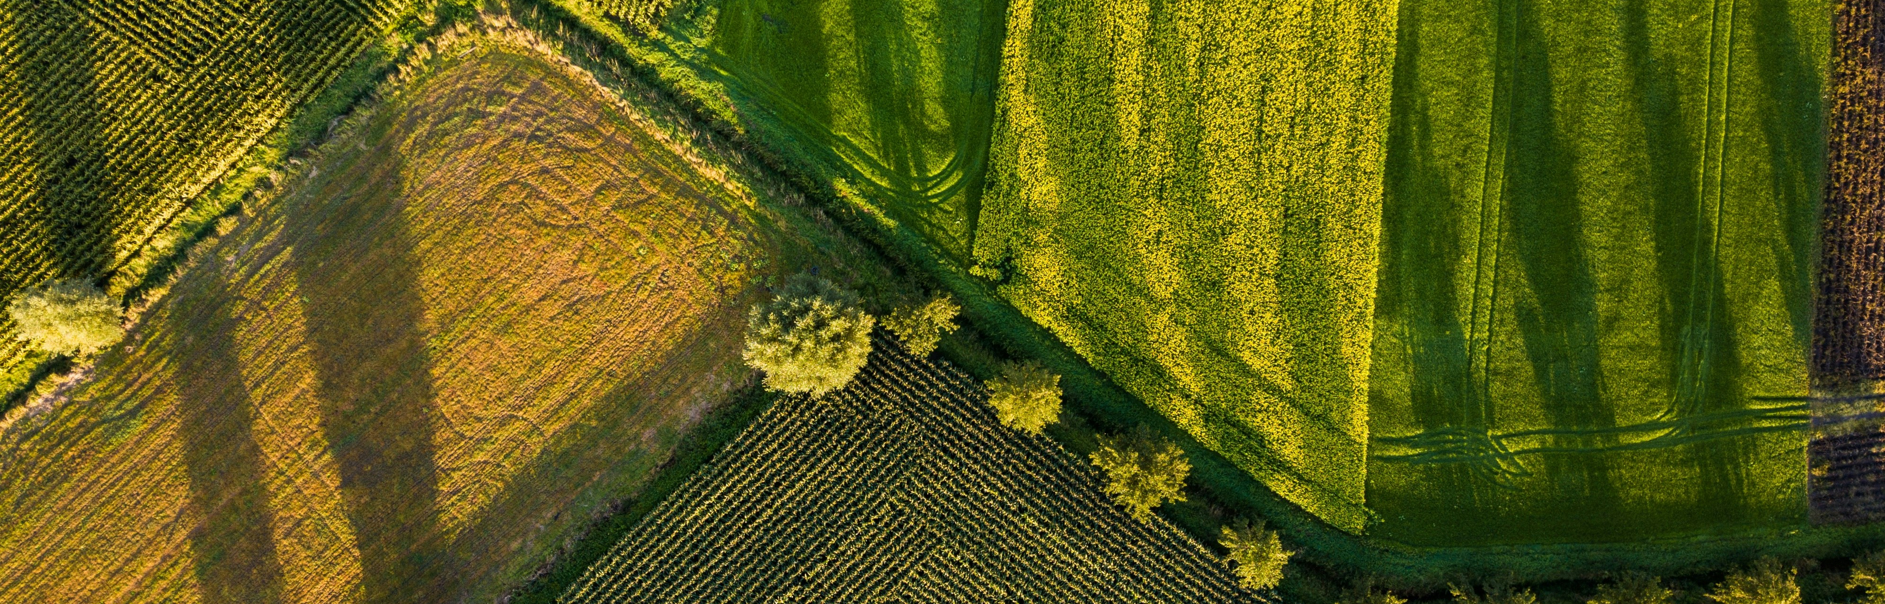
Real-Time Data Integration
The system supports near real-time operational monitoring through:
Automated retrieval of latest Sentinel-2 LAI via Odata.
AOI-based clipping, cloud masking, smoothing.
Standardized ingestion into inferencing pipeline
Value
Provides continuous, scalable growth monitoring without field presence.

Slide 22

Business Insights
Supports early interventions that prevent 10–30% avoidable yield loss.
Enables precision irrigation and nutrient optimization.
Reduces manual scouting effort and operational costs.
Scales across fields, seasons, and management practices.
Provides data-driven insights for agronomic consulting and farm management

Slide 23
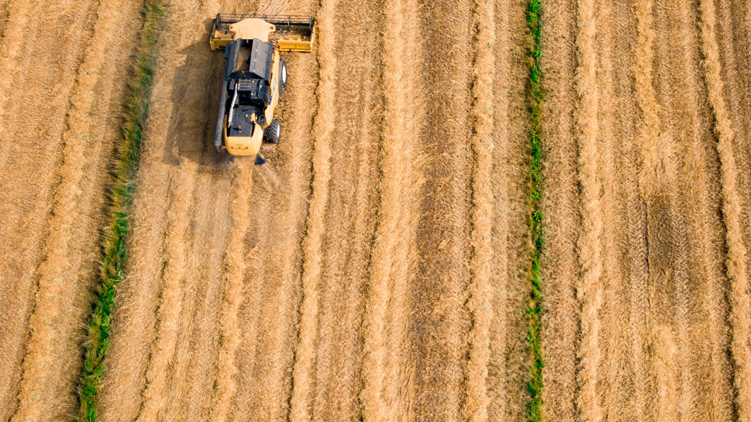
CONCLUSION
Established a reliable end-to-end LAI monitoring and forecasting engine.
Identified key environmental variables driving canopy development.
Demonstrated model responsiveness through sensitivity tests.
Validated feasibility of real-time satellite integration.
Positioned for scalable deployment in production agriculture

Slide 24

THANK YOU

